Slide 1


PANIMALAR INSTITUTE OF TECHNOLOGY
DEPARTMENT OF COMPUTER SCIENCE AND ENGINEERING
AUTOMATION OF MESSAGE SENDING PROCESS USING RPA BLUEPRISM
TEAM MEMBERS:
Harini S(211519104051)
Sruthi B(211519104160)
Sujitha S(211519104162)
TEAM MENTOR:
Dr. W. Gracy Theresa M.E, PHD. PROFESSOR
CSE DEPARTMENT
Batch No: C17

Slide 2

ABSTRACT
Automating the sending congratulatory messages and images to colleagues in the WhatsApp messenger using its web version “WhatsApp Web” due to the lack of an official API for creating bots. In the modern world, we often face the problem of lack of time. Each person has to do many different things every day. Therefore, sometimes people forget about the important thing about maintaining a connection. Indeed, it takes a significant amount of time to pay attention to everyone. Because of this, people rarely write to each other, and sometimes they completely forget to congratulate a colleague on an important holiday for him. To get rid of the daily time spent, it was decided to create a program that would send cards to colleagues on holidays, birthdays, anniversaries and could also interact with them using command. The replies are sent out automatically without needing any human intervention by bot. WhatsApp automated messages are pre-set replies to messages received from new or existing customers on WhatsApp. This feature gives you the bandwidth to respond to customer messages even outside of business hours. The promptness and efficiency with which customers receive responses from your business are bound to improve their satisfaction. The aim of this research project is to propose an end-to-end model for human activity recognition.

Slide 3
LITERATURE SURVEY:
PAPER TITLE | AUTHOR | METHOD | ADVANTAGE | DISADVANTAGE
Future for scientific computing using python | Rakesh Kumar | Matplotlib, NumPy, Python, Pandas, Scientific Computing. | Python is frequently used for high-performance scientific applications and widely used in academia as well as scientific projects because it is easy to write and performs well. | Due to its high-performance nature, scientific computing in Python often utilizes external libraries like NumPy, SciPy and Matplotlib etc.
Web based automation testing and tools | Monika Sharma, Rigzin Angmo | Testing, Web Automation | The quality assurance of a system depends upon automation testing that decreases the test cost and increases work efficiency. | The tool needs to be compatible with the design and implementation of an application.
Design of automation scripts execution application for selenium web driver and test NG framework | Rishab Jain C and Rajesh Kaluri | TestNG | Automation tools helps in design and execution of test scripts saving time and cost involved in manual testing. | This consumes huge amount of storage space on the secondary storage device. The size of each folder varies depending on the size of xml file.

Slide 4
PAPER TITLE | AUTHOR | METHOD | ADVANTAGE | DISADVANTAGE
Four fundamentals of work-place automation | Michael Chui, James Manyika, and Mehdi Miremadi | Robotics’ Baxter, DeepMind | As the automation of physical and knowledge work advances, many jobs will be redefined rather than eliminated. | The potential of artificial intelligence and advanced robotics to perform tasks once reserved for humans is no longer reserved for spectacular demonstrations.
Create WhatsApp bot for your business and test it real time | Jiaqi Pan | Chatbot, NLP | With the expanding features and capabilities of WhatsApp Business API Platforms, more and more businesses opt for WhatsApp bot solutions to communicate with their customer base. | Chatbots is not unwarranted, as case study after case study shows incredible results in engagement, resolution time, customer satisfaction, and even revenue growth.
Motivating attendee's participation in distance learning via an automatic messaging plugin for the Moodle platform | Luciano R. de Almeida; João Paulo C. L. da Costa | CMS, CGEAD, ENAP | Technological advances in information and communications systems are enabling access to education for millions of students, regardless of their geographical location. | This work proposes a plugin for the e-learning platform Moodle that automatically sends e-mail messages to the students.

Slide 5
ENVIRONMENTAL REQUIREMENTS:
HARDWARE REQUIREMENTS
Processor - 2.0 GHz 32 or 64-bit processor
RAM - 2 GB RAM (32-bit) or 4 GB RAM (64-bit)
Hard Disk - At least 20 GB of available hard-disk space
SOFTWARE REQUIREMENTS
Operating System - Windows 7/8/10
Scripts - Microsoft .NET Framework 4.8
Tool - RPA Blue Prism

Slide 6
EXISTING SYSTEM
When analyzing already existing user it was discovered that there are bots that perform various functions.
But no bots were found to send messages based on date and time. And also bot doesn’t takes the information from the human messages and store for future use. Bots in the WhatsApp messenger are nothing new.
Although they are used less frequently than in other applications, they are convenient tools for business. Bot Creators articles say that bots on WhatsApp are different from other bots.
Because of this, their implementation is more difficult, but bots turn out to be complete with the right approach. Automated processes are also less flexible than humans.
Automation doesn’t handle change very well because tools are generally built for a very specific purpose and only a previously specified set of data and formats can be utilized.
This means that humans are generally more flexible and able to respond to change. A comprehensive business case must be built when considering the implementation of this technology.

Slide 7
DISADVANTAGES:
Due to this it will have low performance and low accuracy.
At a certain point in time, it will have to connect to an actual human to resolve the issues.
They also have limited replies and solutions which can leave a customer unsatisfied.

Slide 8
PROPOSED SYSTEM
Nowadays, the popularity of messengers is growing, so it is important to automate processes and create bots.
Using the web version of the messenger does not limit the bot's capabilities, so this method is working for creating bots created for private use. The file system used in the program works more stable, since the main code does not change.
The file system used in the program works more stable, since the main code does not change. At the moment, the bot has great potential, since the main functions were written.
A bot was developed that allows you to automate the process of sending congratulations to relatives, and also has good potential for further work with WhatsApp.

Slide 9
ADVANTAGES:
It is very accurate and time saving
They help you get to know your customers. Conversational chatbots can help you get to know your customers even better.
They allow you to find out what their most common questions and needs are, as well as the products or services that interest them.

Slide 10
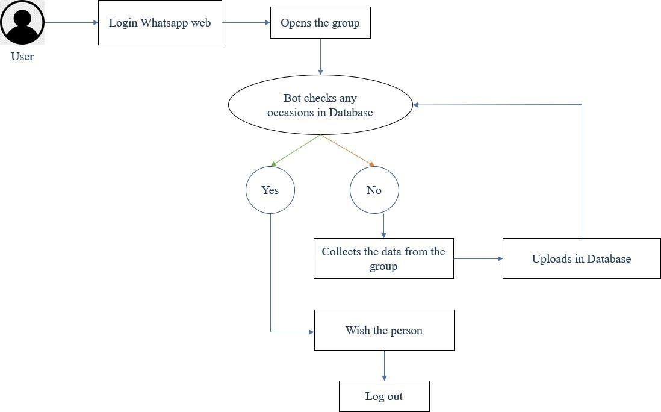
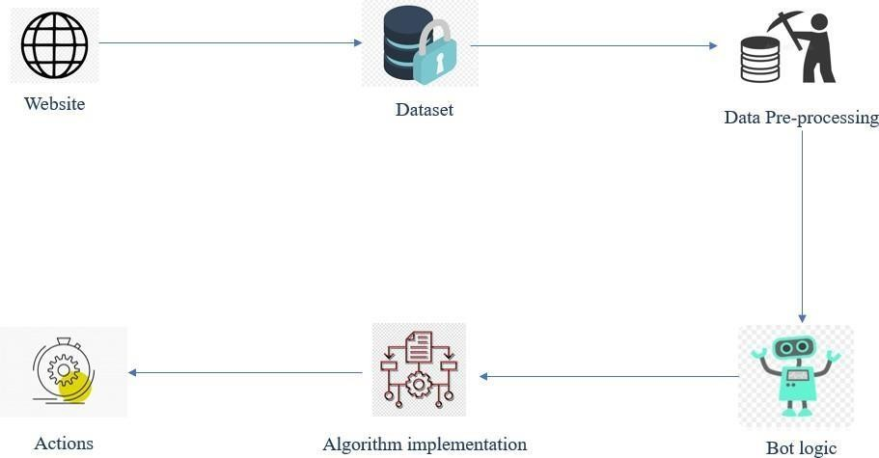
SYSTEM ARCHITECTURE:

Slide 11
LIST OF MODULES:
Data pre-processing
Bot logic
A* Algorithm
D* Algorithm
Deployment

Slide 12
MODULES EXPLANATION:
1. DATA PRE-PROCESSING:
Preprocessing simply refers to perform series of operations to transform or change data. It is transformation applied to our data before feeding it to algorithm. Data processing refers to perform operations on data to retrieve, transform, or change data, especially by computer. It is technique that is used to convert raw data into clean data set. In other words, whenever data is gathered from different sources, it is collected in raw format, which is not feasible for analysis. Then it converts raw format into readable format (graphs, documents, etc.), so that it can be interpreted by computers and utilized by employees throughout an organization. It transforms raw data into meaningful information.

Slide 13
2. BOT LOGIC:
A bot is an app that users interact with in a conversational way, using text, graphics or speech. Each channel can include additional information in the activities they send. Before creating bots, it's important to understand how a bot uses activity objects to communicate with its users. There are two activity types, conversation update and message, that might be exchanged when a user communicates with an echo bot. The Bot Framework Service sends a conversation update when a party joins the conversation. For example, on starting a conversation with the Bot Framework Emulator, you might see two conversation update activities (one for the user joining the conversation and one for the bot joining). To distinguish these conversation update activities, check who is included in the members added property of the activity. The message activity carries conversation information between the parties. In an echo bot example, the message activities are carrying simple text and the channel will render this text. Alternatively, the message activity might carry text to be spoken, suggested actions or cards to be displayed.

Slide 14
3. A* ALGORITHM
The A* algorithm is a path search algorithm that is used to find the most optimal path between two points, i.e., with the smallest cost. Anytime A* Algorithm has a flexible time cost and can return the shortest path even if it is interrupted as it generates a non-optimal solution first and then optimizes it. This allows for faster decision making as the robot can build upon previous calculations instead of starting from scratch.
4. D* ALGORITHM
D*, Focused D* and D* Lite are incremental search algorithms to find the shortest path between two points. They, however, are a mixture of A* algorithms and new discoveries that allow them to add information to their maps for unknown obstacles. D* and its variants are widely used for mobile robot and autonomous vehicle navigation.

Slide 15
5. DEPLOYMENT
Each module has a set of deployment properties associated with it by default; these are stored in the deployment descriptor file. Any changes that you directly make to module deployment properties in deployment descriptor files are typically overwritten when the deploy code is next regenerated. However, you can use the module deployment editor to specify and retain changes to module deployment properties. The module deployment editor saves your changes to a deployment side file, which is used to automatically update the module deployment properties in the deployment descriptor files whenever the deploy code is regenerated or the module is installed on the server. Model deployment is the process of putting machine learning models into production. This makes the model’s predictions available to users, developers or systems, so they can make business decisions based on data, interact with their application (like recognize a face in an image) and so on

Slide 16
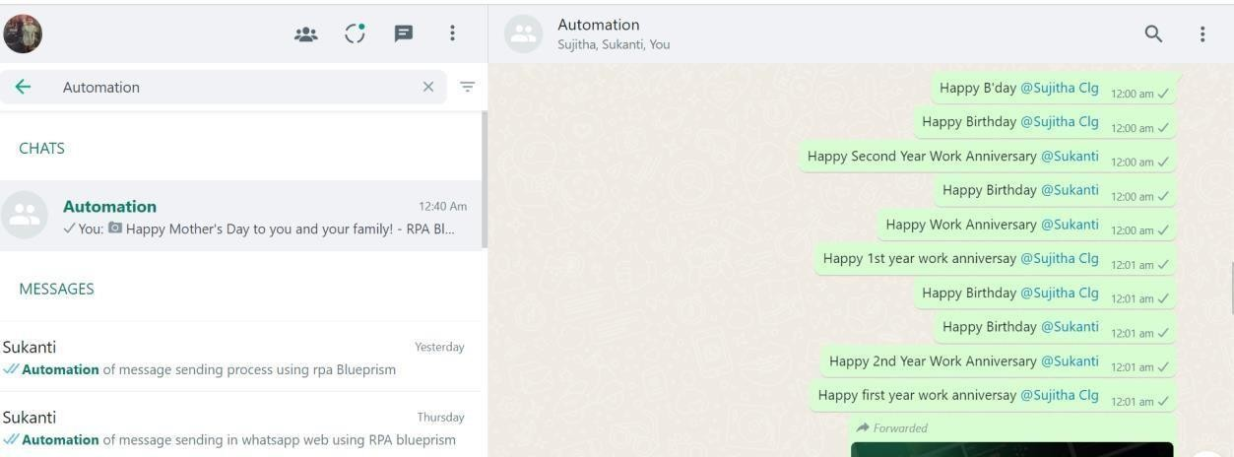
SCREENSHOTS:

Slide 17
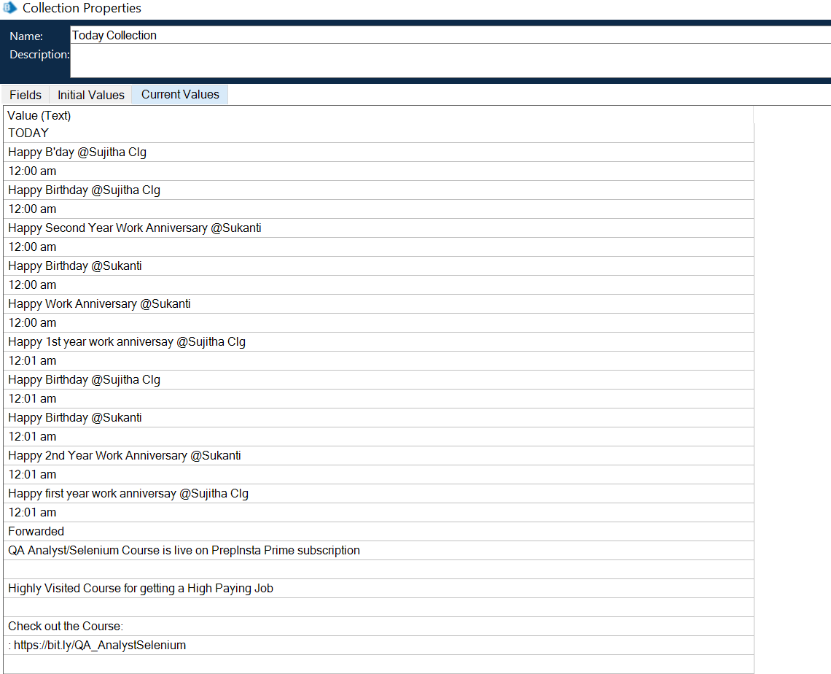

Slide 18
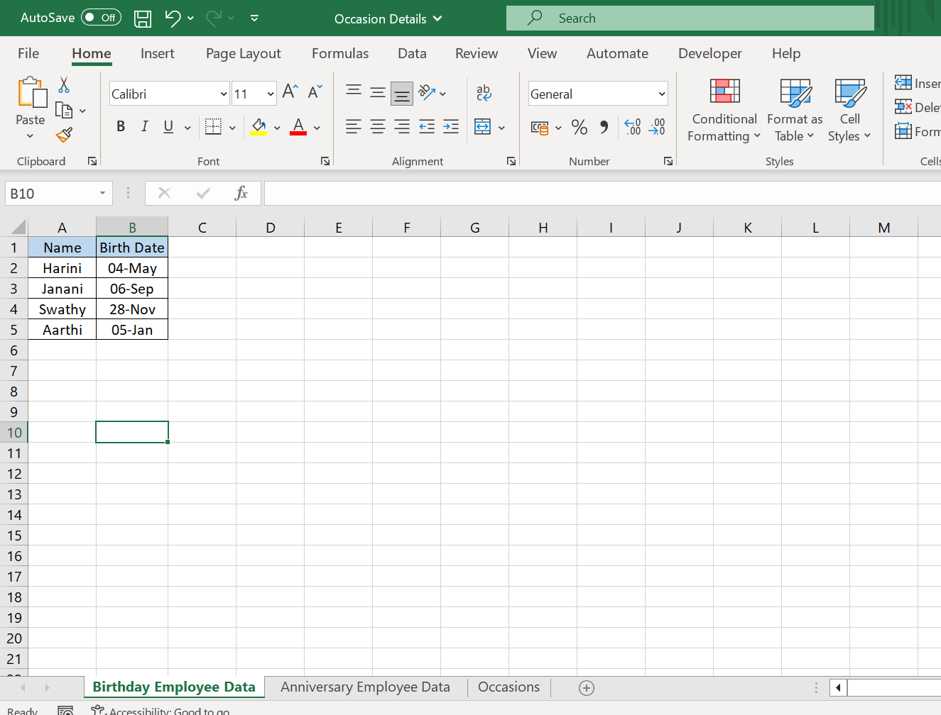
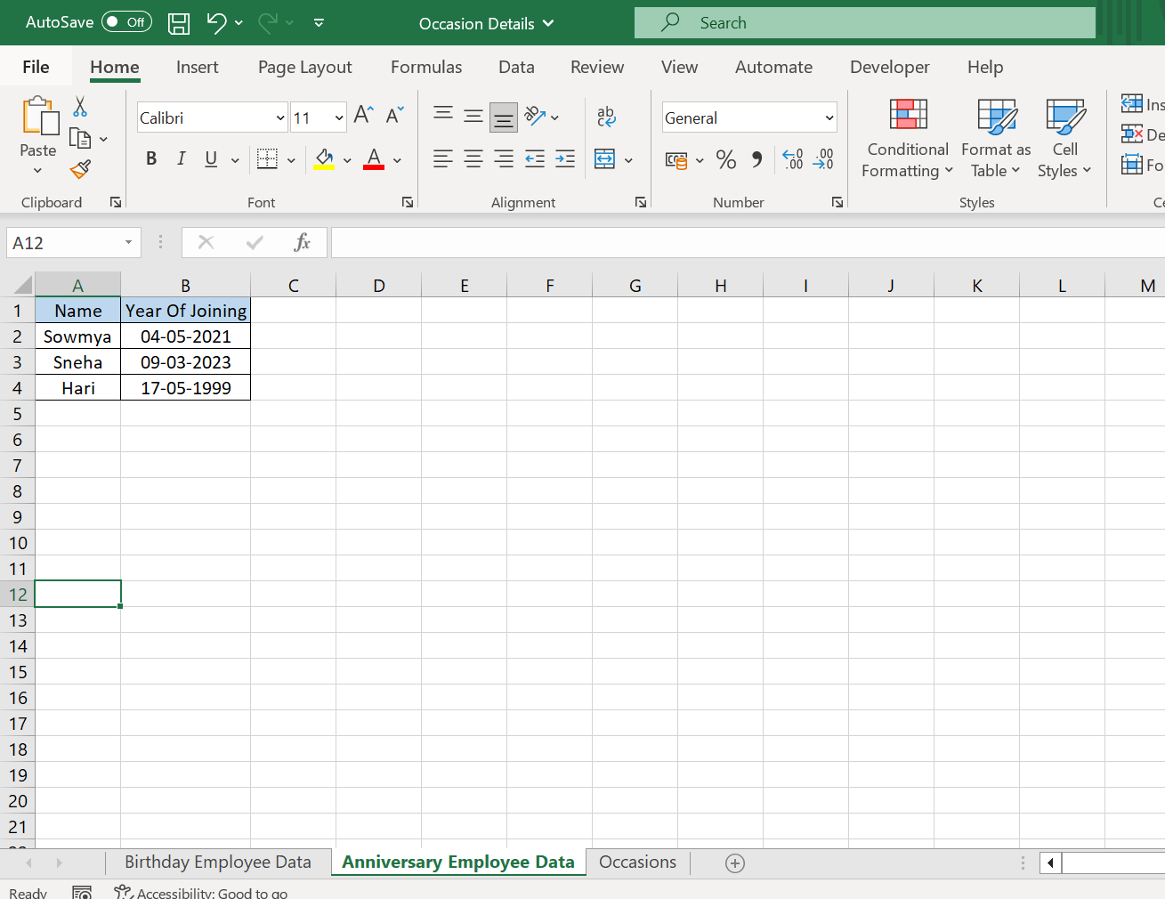

Slide 19
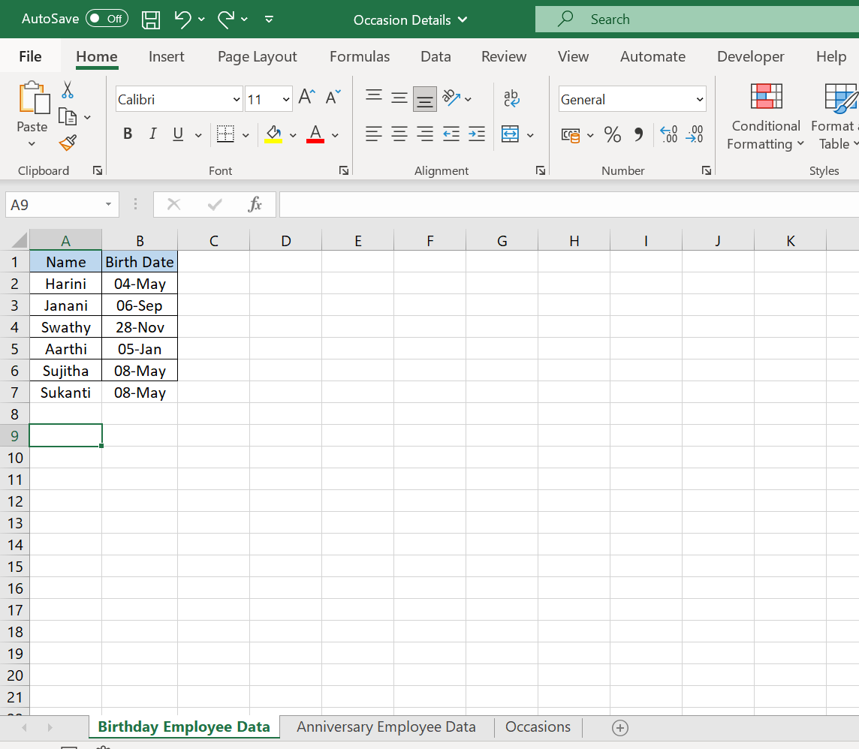
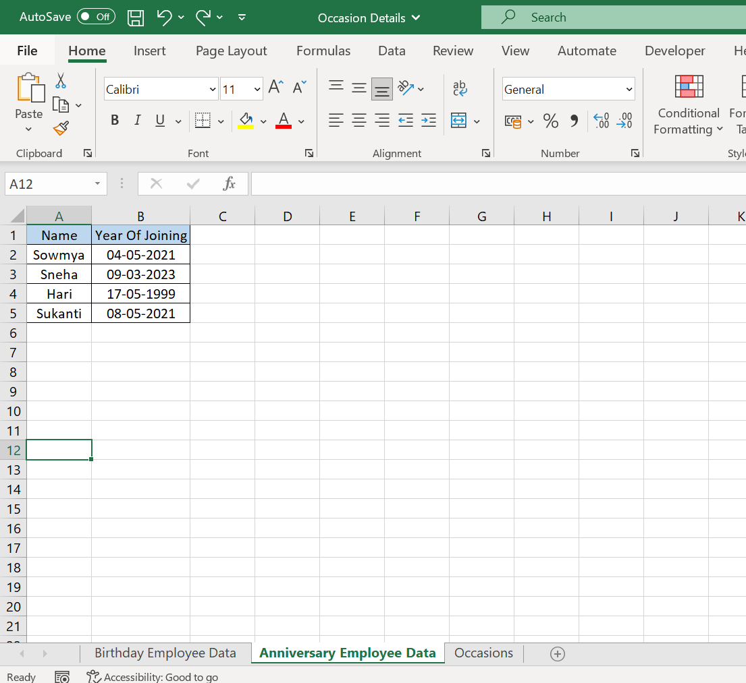

Slide 20
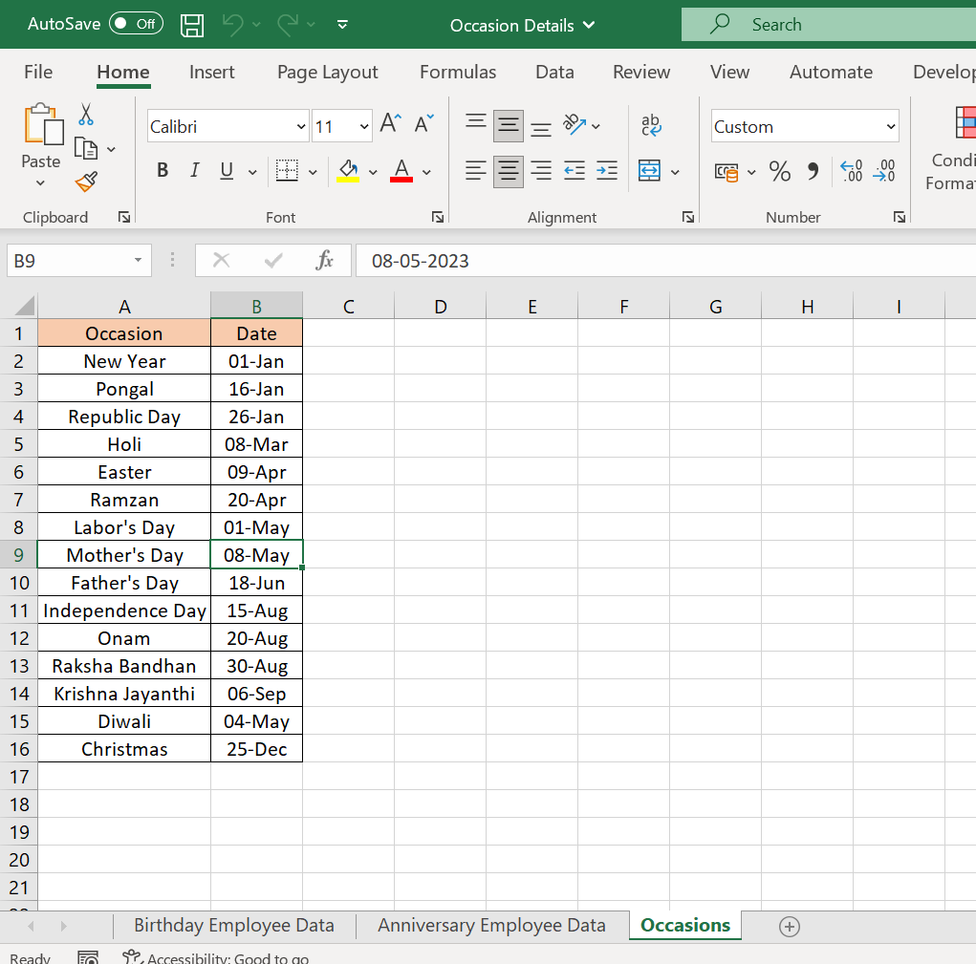

Slide 21
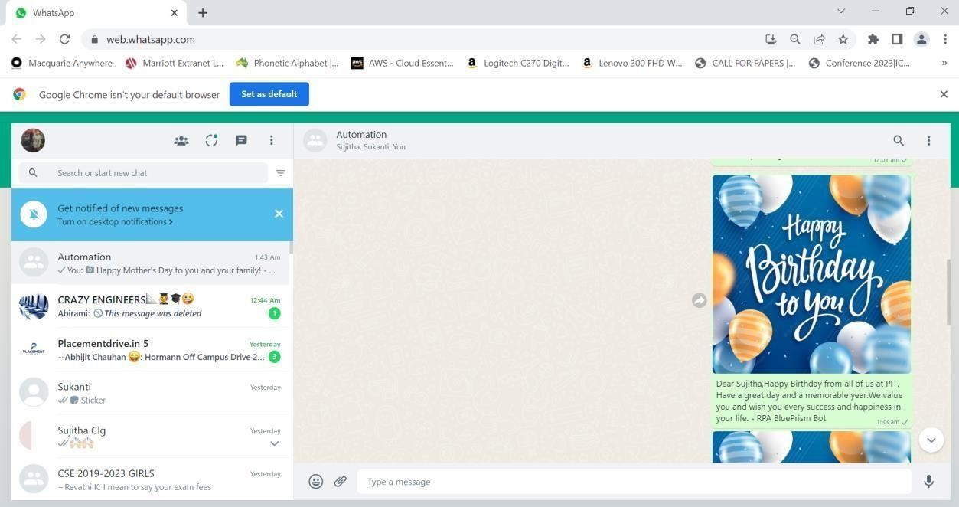

Slide 22
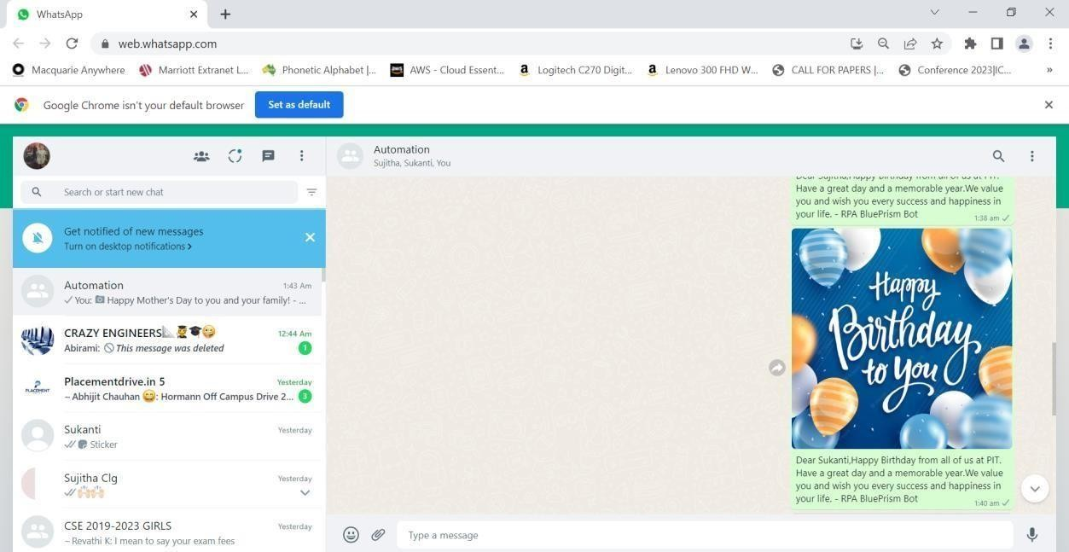

Slide 23
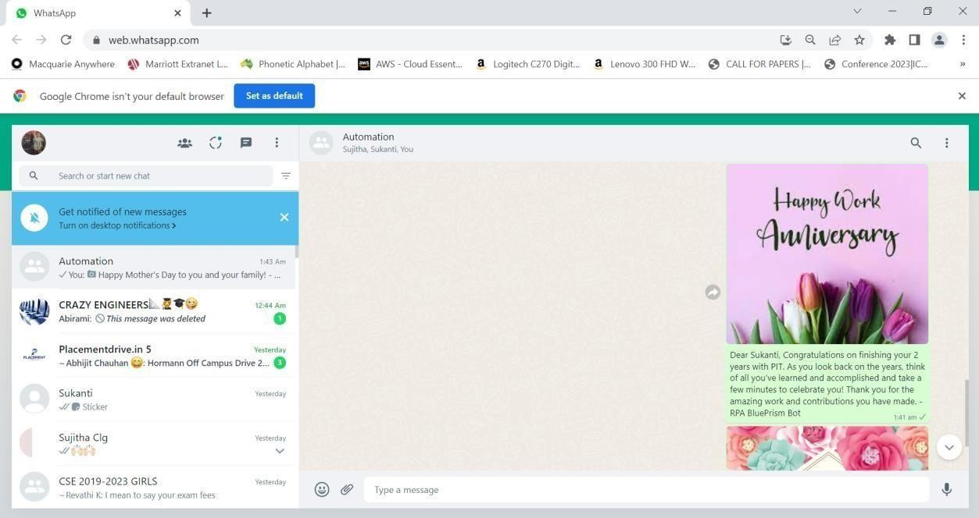

Slide 24
CONCLUSION
Based on the analysis and the results of the experiment, a number of conclusions were drawn, including further areas of research. Nowadays, the popularity of messengers is growing, so it is important to automate processes and create bots. Using the web version of the messenger does not limit the bot's capabilities, so this method is working for creating bots created for private use. The file system used in the program works more stable, since the main code does not change. At the moment, the bot has great potential, since the main functions were written. You can make almost anything out of them. As the next task, you can add the number of commands to the bot, for example, display the weather forecast, or display the schedule of a TV channel. Thus, a bot was developed that allows you to automate the process of sending congratulations to colleagues, and also has good potential for further work with WhatsApp.

Slide 25
REFERENCES
[1]. Messina Chris. 2016 will be the year of conversational commerce //A Medium Corporation. URL: https://medium.com/chris-messina/2016- will-be-the-year-of- conversational-commerce-1586e85e399 (accessed: 25.09.2020) (in Russ.)
[2].https://www.sostav.ru/publication/messendzhery-vs-sotsseti-kto-vblizhajshee- vremya-pobedit-v-reklamnoj-skhvatke26339.html(accessed: 25.09.2020) (in Russ.)
[3]. Why do you need your own WhatsApp bot? //Bot creators. URL: https://botcreators.ru/blog/pochemu-vam-nuzhen-chat-bot-v-whatsappobzor- platformy- dlya-bota/ (accessed: 25.09.2020) (in Russ)
[4]. "Automation in the workplace 2017", 2017, [online] Available: https://www.smartsheet.com/sites/default/files/smartsheet-automation-workplace.pdf.
[5]. R. Kumar, "Future for scientific computing using python", International Journal of Engineering Technologies and Management Research2, pp. 30-41.

Slide 26

Thank You!

